Slide 1

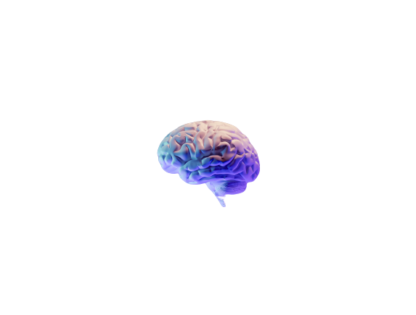
Brain Tumor Detection
GURU NANAK INSTITUTE OF TECHNOLOGY
Department of Computer Science and Engineering
Project Definition Seminar
Date : 21-04-2023
Team Members :
Under the Guidance of :
Pawan H. Raut
HOD (CSE)
Anup S. Belurkar
Sanketraj D. Kanoje
Shashank P. Ramteke
Shubham S. Prasad
Yash A. Raikwar

Slide 2
CONTENT
Introduction
Literature Review
Problem Definition
Present System
Methodology
Software Requirement
Hardware Requirement
Flowchart
Future Scope
Conclusion
Reference

Slide 3
INTRODUCTION
Brain Tumor is the 10th leading cause of death in human beings, so study of brain tumor is important.
Tumor is defined as the abnormal growth of the tissue.
Brain tumor are generally classified into two type Benign and Malignant Tumors.
It is one of the cause for the increase in mortality among children and adults.
The detection of Brain Tumor using MRI Image is challenging task because of complex structure of the brain.
In this project our focus will be mainly to improve the existing approaches of image preprocessing or to design a better approach for the detection of the tumor.

Slide 4
LITERATURE REVIEW
In recent years, interest in designing tools for diagnosing brain tumors has been increasing. The work of Gopal and Karnan uses image processing clustering algorithms to classify images into a group that has a brain tumor and another group which does not. The dataset used in this work is composed of 42 MRI images obtained from the KG hospital database.
The authors then use an algorithm called Fuzzy C Means (FCM) as an image clustering algorithm, in addition to using a Genetic Algorithm (GA) as an intelligent optimization tool.
To enhance the accuracy, the authors used an optimization technique called Particle Swarm Optimization (PSO). They managed to reach an accuracy level of 92%.

Slide 5


PROBLEM DEFINITION
Now a days we have seen most of Tumor life threatening where brain tumor being one of them.
As we know that brain tumor can be of any size, shape, position, and intensity.
Therefore, it is very difficult to detect tumor and diagnose it.
The manual identification of tumor from MRI image is subjective in nature and many where from expert to expert depending on their expertise and other factors.
Which includes lack of specific and accurate qunatitaive measure to classify the MRI image as it is Brain Tumor or not.

Slide 6

PRESENT SYSTEM
In our system we have dataset of around 500 MRI images some of which contain brain tumor and some are not contain brain tumor so our system read all MRI images and process from this MRI images will detect the position of brain tumor and where mostly brain tumor found by using segmentation process can targeting boundary set of brain tumor to MRI image.
After performing HU moments, Haralicks, Histogram and Data normalization methods we will get Result in the form of Accuracy graph, Precision graph, recall graph and F-measure graph.
This system is expected to improve the sensitivity, specificity, and diagnostic efficiency of brain tumor screening.

Slide 7
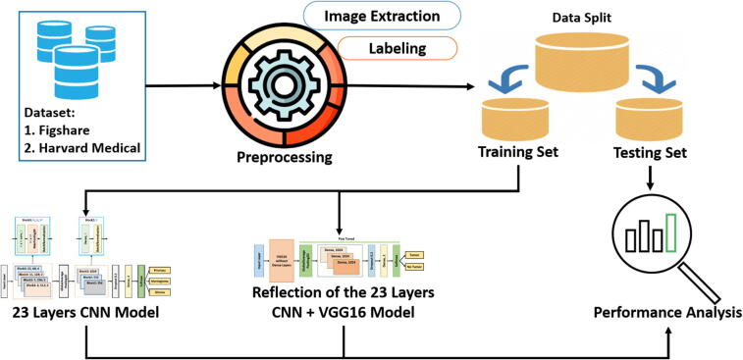
METHODOLOGY

Slide 8
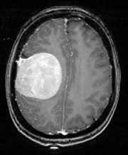
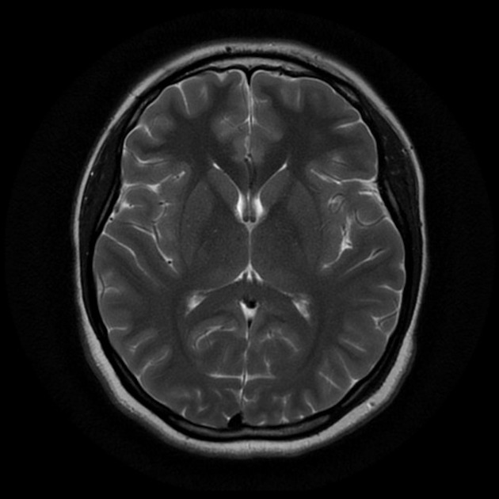
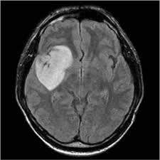
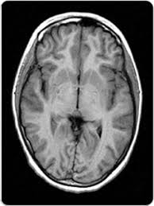
DATASET
MRI IMAGE
Dataset Link
Brain MRI dataset https://www.kaggle.com/abhranta/brain-tumor-detection-mri

Slide 9
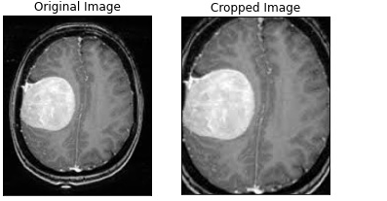
PREPRPCESSING
IMAGE EXTRACTION

Slide 10
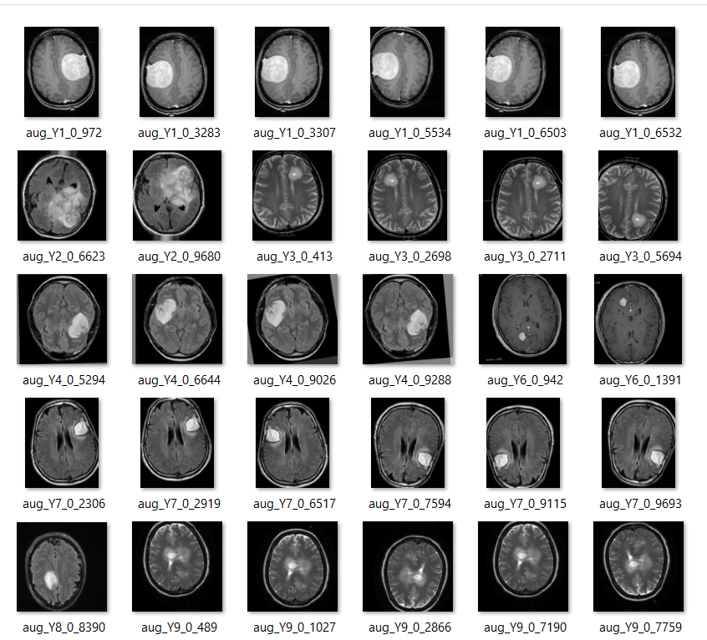
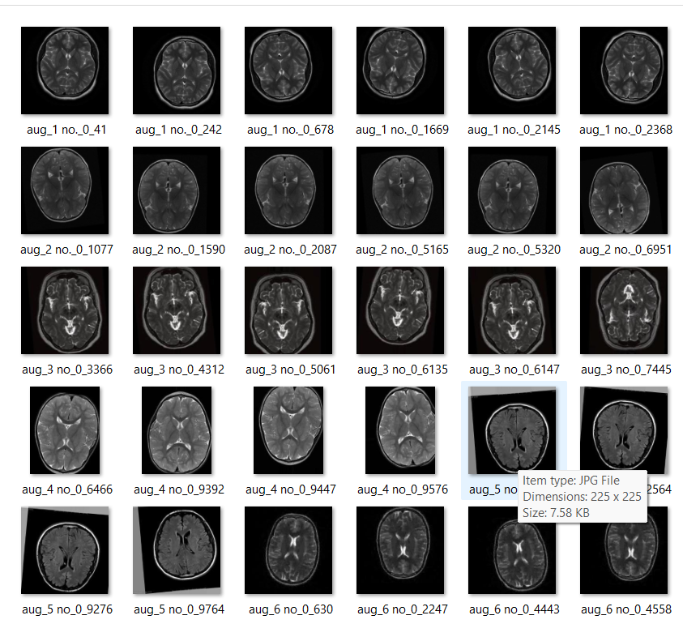
PREPROCESSING
LABELING

Slide 11
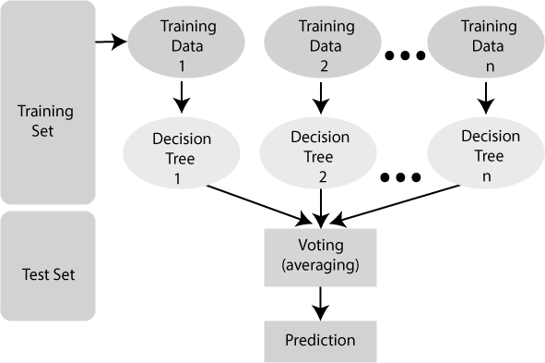
METHODOLOGY
DATA SPLIT

Slide 12
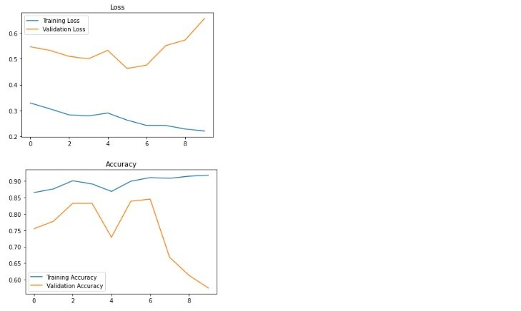
METHODOLOGY
PERFORMANCE ANALYSIS

Slide 13
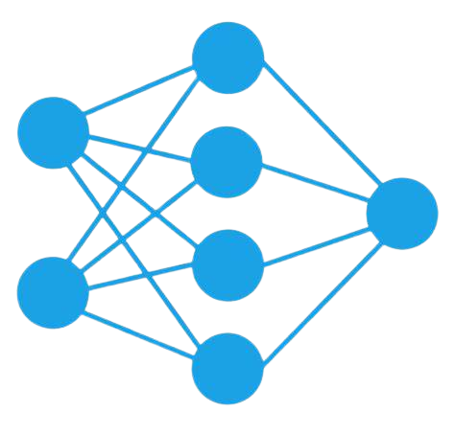


METHODOLOGY
Our proposed block diagram for automated binary and multiclass brain tumor detection is shown in figure. The architecture starts with image extraction and loading labels from the dataset. The extracted images then need to be preprocessed before splitting them into training, validation, and test set. Finally, our proposed “23-layers CNN” and the “Fine-tuned VGG16” architectures are applied to the employed datasets.

Slide 14
METHODOLOGY
MODULES TO BE USED IN OUR PROJECT
Read Dataset
Pre-Processing
Feature Extraction
HU moments
Haralick
Histogram
Data Normalization
Classification
SVM (Support Vector Machine)
Random Forest
Linear Regression

Slide 15


SOFTWARE REQUIREMENT
Sr. no. | Requirement | Tools used
1. | Operating system | Windows 10
2. | Frontend | Python 3.7
3. | Python Libraries | OpenCV2 TensorFlow PIL Numpy Keras Sklearn

Slide 16
HARDWARE REQUIREMENT
Sr. no. | Requirement | Tools used
1. | Processor | Intel i5 7th gen. /AMD Ryzen5 (3400G) or Above
2. | RAM | 4-6 GB
3. | Hard Disk Storage | 500 GB

Slide 17
FLOWCHART
MRI Images (Dataset)
Preprocessing
RGB to Gray Scale Conversion
Segmentation of MRI Image
Feature Extraction using Texture based feature
HU Moments
Haralick
Histogram
Data Normalization
ML(Training-Testing)
Classification
Support vector Machine (SVM)
Random Forest
Linear Regression
Result

Slide 18
FUTURE SCOPE
Although our proposed models achieved promising classification outcomes, there are still a number of issues that can be resolved in the future work.
One of the key difficulties in using the deep learning-based automated detection of brain tumor is the requirement for a substantial amount of annotated images collected by a qualified physician or radiologist.
In order to make a robust deep learning model, we would require a large dataset.
To the best of our knowledge, the majority of contemporary machine learning tools for medical imaging have this constraint.
Adopting zero-shot, few-shot, and deep reinforcement learning (DRL) techniques could help us to tackle this problem in the future.

Slide 19
CONCLUSION
Deep learning network models have obtained good results in recent years in the medical image analysis field. In this model, we implemented the necessary phases such as image sharpening, high pass filter, thresholding segmentation, growing seed approach, and classification based on deep wavelet auto-encoder model for feature extraction; the implementation produced excellent results.
The advantage of this proposed method is its excellent ability to analyze extensive data from magnetic resonance images of the brain without technical problems and with very high accuracy, which will help doctors in the accurate diagnosis of brain tumors.

Slide 20
REFRENCES
N. N. Gopal and M. Karnan. Diagnose brain Komal Sharma, AkwinderKaur, ShrutiGujral," Brain Tumor Detection based on Machine Learning Algorithms",International Journal of Computer Applications (0975 – 8887)Volume 103– No.1, October 2014. http://iriset.org/images/extraimages/Paper%20ID%201411003B%20.pdf
Natarajan P, Krishnan.N, Natasha SandeepKenkre, Shraiya Nancy, Bhuvanesh PratapSingh,"Tumor Detectionusing threshold operation in MRI Brain Images" , IEEEInternational Conference on Computational Intelligence and Computing Research, 2012. https://ieeexplore.ieee.org/document/6510299

Slide 21

Thanks!
Any questions

